Slide 1

Advanced CSS
BCAC 0016 FUNDAMENTALS OF INTERNET PROGRAMMING
Module 2
Dr. Kanta Prasad Sharma
Assistant Professor,
Department of Computer Engineering and Applications,
GLA University, Mathura

Slide 2
Outline
Shadow Effects
Text Effects
Tooltips
Styling Images
BCAC0016: Fundamentals of Internet Programming

Slide 3
CSS – Shadow Effects
With CSS you can add shadow to text and to elements.
CSS Text Shadow
The CSS text-shadow property applies shadow to text.
In its simplest use, you only specify the horizontal shadow (2px) and the vertical shadow (2px):
h1 { text-shadow: 2px 2px; }
BCAC0016: Fundamentals of Internet Programming

Slide 4
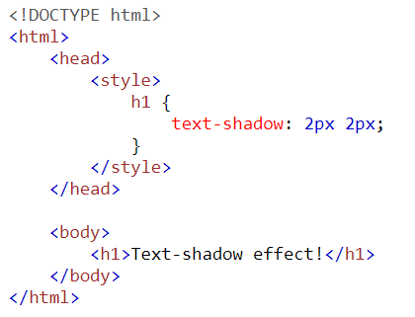

CSS – Shadow Effects (Contd.)
OUTPUT:
BCAC0016: Fundamentals of Internet Programming

Slide 5


CSS – Shadow Effects (Contd.)
To add a color to the shadow:
h1 { text-shadow: 2px 2px red; }
To add a blur effect to the shadow:
h1 { text-shadow: 2px 2px 5px red; }
BCAC0016: Fundamentals of Internet Programming

Slide 6


CSS – Text Effects
CSS Text Overflow
The CSS text-overflow property specifies how overflowed content that is not displayed should be signaled to the user.
It can be clipped:
or it can be rendered as an ellipsis (...):
BCAC0016: Fundamentals of Internet Programming

Slide 7
CSS – Text Effects (Contd.)
The CSS code is as follows:
p.test1 { white-space: nowrap; width: 200px; border: 1px solid #000000; overflow: hidden; text-overflow: clip; }
p.test2 { white-space: nowrap; width: 200px; border: 1px solid #000000; overflow: hidden; text-overflow: ellipsis; }
BCAC0016: Fundamentals of Internet Programming

Slide 8
CSS – Text Effects Properties
The following table lists the CSS text effect properties:
Property | Description
text-justify | Specifies how justified text should be aligned and spaced
text-overflow | Specifies how overflowed content that is not displayed should be signaled to the user
word-break | Specifies line breaking rules for non-CJK scripts
word-wrap | Allows long words to be able to be broken and wrap onto the next line
writing-mode | Specifies whether lines of text are laid out horizontally or vertically
BCAC0016: Fundamentals of Internet Programming

Slide 9
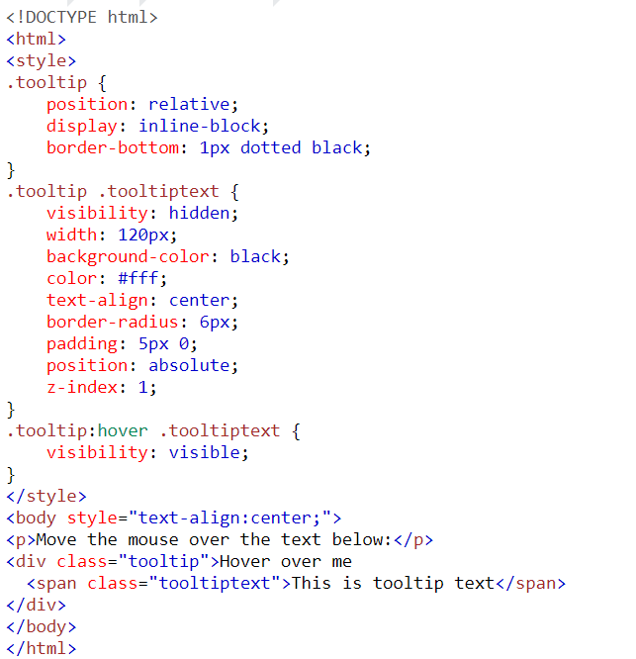
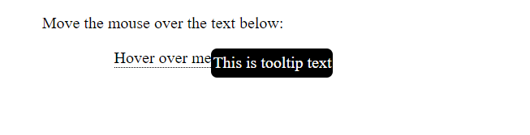
CSS – Tooltips
A tooltip is often used to specify extra information about something when the user moves the mouse pointer over an element:
BCAC0016: Fundamentals of Internet Programming

Slide 10

HAPPY NEW YEAR DEAR CLASS

Slide 11


CSS – Styling Images
Use the border-radius property to create rounded images:
Rounded Image:
img { border-radius: 8px; }
Circled Image:
img { border-radius: 50%; }
BCAC0016: Fundamentals of Internet Programming

Slide 12

CSS – Styling Images (Contd.)
Use the border property to create thumbnail images:
img { border: 1px solid #ddd;
border-radius: 4px;
padding: 5px;
width: 150px; }
BCAC0016: Fundamentals of Internet Programming

Slide 13
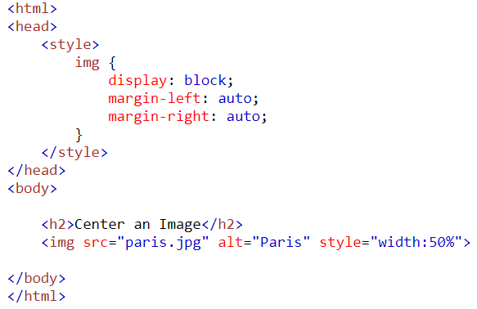
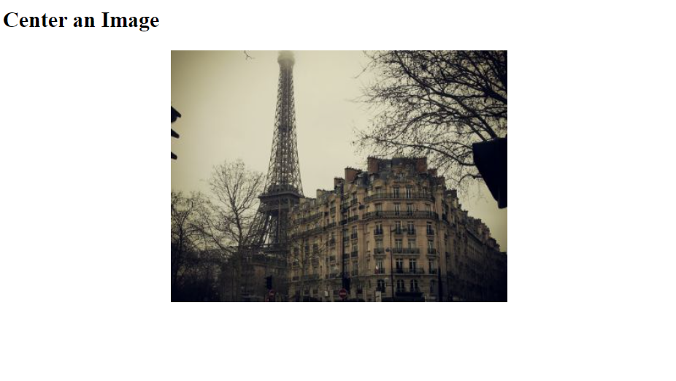
CSS – Styling Images (Contd.)
To center an image, set left and right margin to auto and make it into a block element:
OUTPUT:
BCAC0016: Fundamentals of Internet Programming

Slide 14
CSS – Styling Images (Contd.)
The opacity property can take a value from 0.0 - 1.0. The lower value, the more transparent.
The CSS filter property adds visual effects (like blur and saturation) to an element.
The filter property is not supported in Internet Explorer or Edge 12.
Example:
Change the color of all images to black and white (100% gray):
img { filter: grayscale(100%); }
BCAC0016: Fundamentals of Internet Programming

Slide 15
CSS – Styling Images (Contd.)
An image can be flipped using CSS, when your mouse is moved over the image using the following code:
img:hover { transform: scaleX(-1); }
BCAC0016: Fundamentals of Internet Programming

Slide 16
Tables in CSS

Slide 17
CSS Tables
The look of an HTML table can be greatly improved with CSS.
Table Borders
To specify table borders in CSS, use the border property.
The following example specifies a solid border for <table>, <th>, and <td> elements:
BCAC0016: Fundamentals of Internet Programming

Slide 18
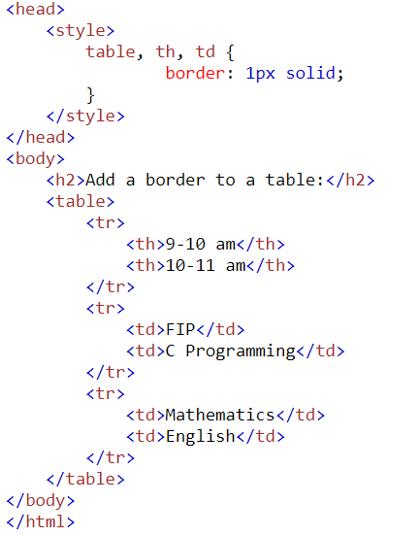
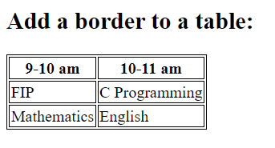
CSS Tables (Contd.)
OUTPUT:
BCAC0016: Fundamentals of Internet Programming

Slide 19
CSS Tables (Contd.)
The look of an HTML table can be greatly improved with CSS.
Full-Width Table
The table above might seem small in some cases. If you need a table that should span the entire screen (full-width), add width: 100% to the <table> element:
Example:
table { width: 100%; }
BCAC0016: Fundamentals of Internet Programming

Slide 20
CSS Tables (Contd.)
If you only want a border around the table, only specify the border property for <table>:
table { border: 1px solid; }
BCAC0016: Fundamentals of Internet Programming

Slide 21
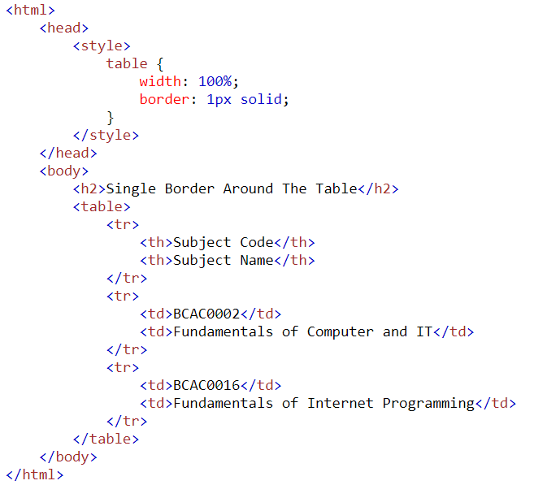
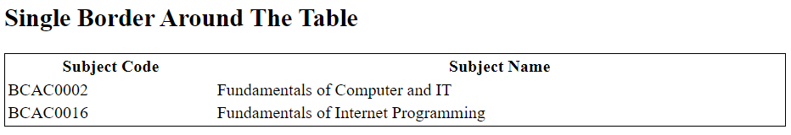
CSS Tables (Contd.)
OUTPUT:
BCAC0016: Fundamentals of Internet Programming

Slide 22
CSS Tables (Contd.)
Table Width and Height
The width and height of a table are defined by the width and height properties.
The example below sets the width of the table to 100%, and the height of the <th> elements to 70px:
Example:
table { width: 100%; } th { height: 70px; }
BCAC0016: Fundamentals of Internet Programming

Slide 23
CSS Tables (Contd.)
Horizontal Alignment
The text-align property sets the horizontal alignment (like left, right, or center) of the content in <th> or <td>.
By default, the content of <th> elements are center-aligned and the content of <td> elements are left-aligned.
To center-align the content of <td> elements as well, text-align: center:
td { text-align: center; }
BCAC0016: Fundamentals of Internet Programming

Slide 24
CSS Tables (Contd.)
Vertical Alignment
The vertical-align property sets the vertical alignment (like top, bottom, or middle) of the content in <th> or <td>.
By default, the vertical alignment of the content in a table is middle (for both <th> and <td> elements).
The following example sets the vertical text alignment to bottom for <td> elements:
td { height: 50px;
text-align: center; }
BCAC0016: Fundamentals of Internet Programming

Slide 25
CSS Tables (Contd.)
Table Padding
To control the space between the border and the content in a table, use the padding property on <td> and <th> elements:
th, td { padding: 15px;
text-align: left; }
BCAC0016: Fundamentals of Internet Programming

Slide 26
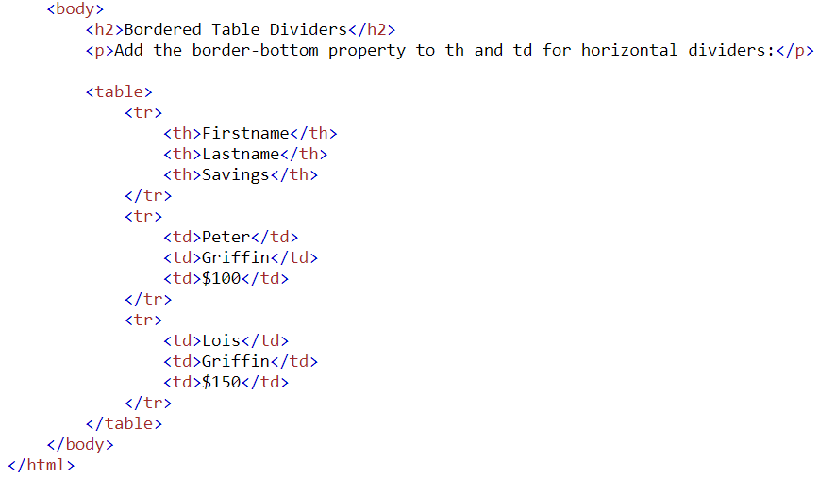
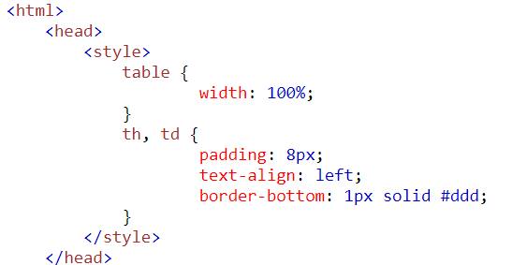
CSS Tables (Contd.)
Horizontal Dividers
Add the border-bottom property to <th> and <td> for horizontal dividers:
BCAC0016: Fundamentals of Internet Programming

Slide 27
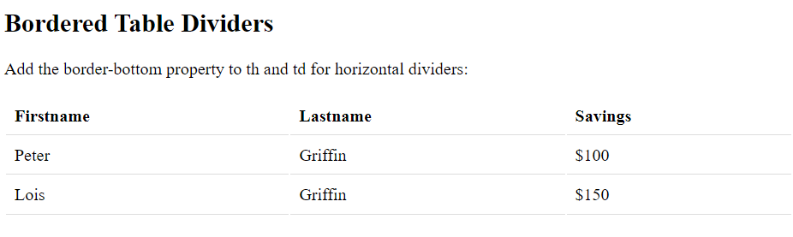
CSS Tables (Contd.)
OUTPUT:
BCAC0016: Fundamentals of Internet Programming

Slide 28
CSS Tables (Contd.)
Hoverable Table
Use the :hover selector on <tr> to highlight table rows on mouse over:
tr:hover { background-color: coral; }
BCAC0016: Fundamentals of Internet Programming

Slide 29
Lists in CSS

Slide 30
Outline
CSS Lists
Unordered Lists
Ordered Lists
BCAC0016: Fundamentals of Internet Programming

Slide 31
CSS Lists
The CSS list properties allow you to:
Set different list item markers for ordered lists
Set different list item markers for unordered lists
Set an image as the list item marker
Add background colors to lists and list items
BCAC0016: Fundamentals of Internet Programming

Slide 32
CSS Lists (Contd.)
Different List Item Markers:
The list-style-type property specifies the type of list item marker.
The following example shows some of the available list item markers:
ul.a { list-style-type: circle; } ul.b { list-style-type: square; }
ol.c { list-style-type: upper-roman; } ol.d { list-style-type: lower-alpha; }
BCAC0016: Fundamentals of Internet Programming

Slide 33
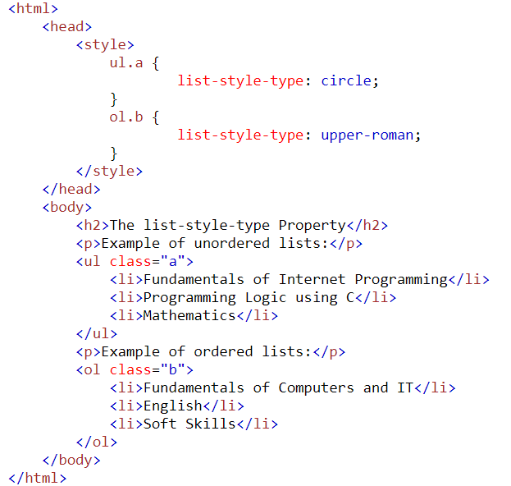
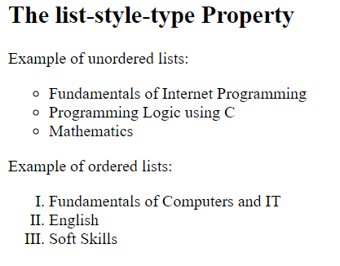
CSS Lists (Contd.)
OUTPUT:
BCAC0016: Fundamentals of Internet Programming

Slide 34
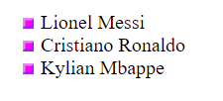
CSS Lists (Contd.)
An Image as The List Item Marker
The list-style-image property specifies an image as the list item marker:
ul { list-style-image: url('sqpurple.gif'); }
<ul>
<li>Lionel Messi</li>
<li>Cristiano Ronaldo</li>
<li>Kylian Mbappe</li>
</ul>
OUTPUT:
BCAC0016: Fundamentals of Internet Programming

Slide 35
CSS Lists (Contd.)
Styling List With Colors:
We can also style lists with colors, to make them look a little more interesting.
Anything added to the <ol> or <ul> tag, affects the entire list, while properties added to the <li> tag will affect the individual list items:
BCAC0016: Fundamentals of Internet Programming

Slide 36
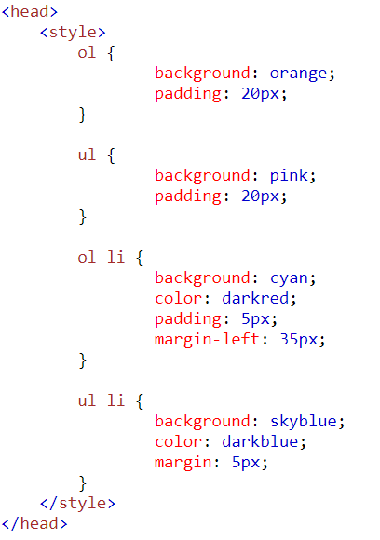
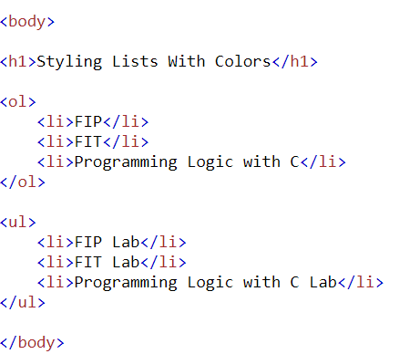
CSS Lists (Contd.)
BCAC0016: Fundamentals of Internet Programming

Slide 37
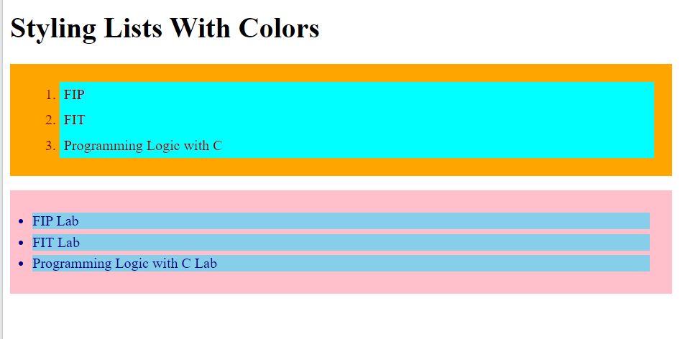
CSS Lists (Contd.)
OUTPUT:
BCAC0016: Fundamentals of Internet Programming

Slide 38
Outline
CSS Links
Link States
Text Decoration
Background Color
BCAC0016: Fundamentals of Internet Programming

Slide 39
CSS Links
With CSS, links can be styled in many different ways.
Styling Links
Links can be styled with any CSS property (e.g. color, font-family, background, etc.).
Example:
a { color: pink; }
BCAC0016: Fundamentals of Internet Programming

Slide 40
CSS Links (Contd.)
In addition, links can be styled differently depending on what state they are in.
The four links states are:
a:link - a normal, unvisited link
a:visited - a link the user has visited
a:hover - a link when the user mouses over it
a:active - a link the moment it is clicked
BCAC0016: Fundamentals of Internet Programming

Slide 41
CSS Links (Contd.)
/* mouse over link */ a:hover { color: pink; } /* selected link */ a:active { color: blue; }
Example:
/* unvisited link */ a:link { color: red; } /* visited link */ a:visited { color: green; }
BCAC0016: Fundamentals of Internet Programming

Slide 42
CSS Links (Contd.)
/* mouse over link */ a:hover { color: pink; } /* selected link */ a:active { color: blue; }
Example:
/* unvisited link */ a:link { color: red; } /* visited link */ a:visited { color: green; }
When setting the style for several link states, there are some order rules:
a:hover MUST come after a:link and a:visited
a:active MUST come after a:hover
BCAC0016: Fundamentals of Internet Programming

Slide 43
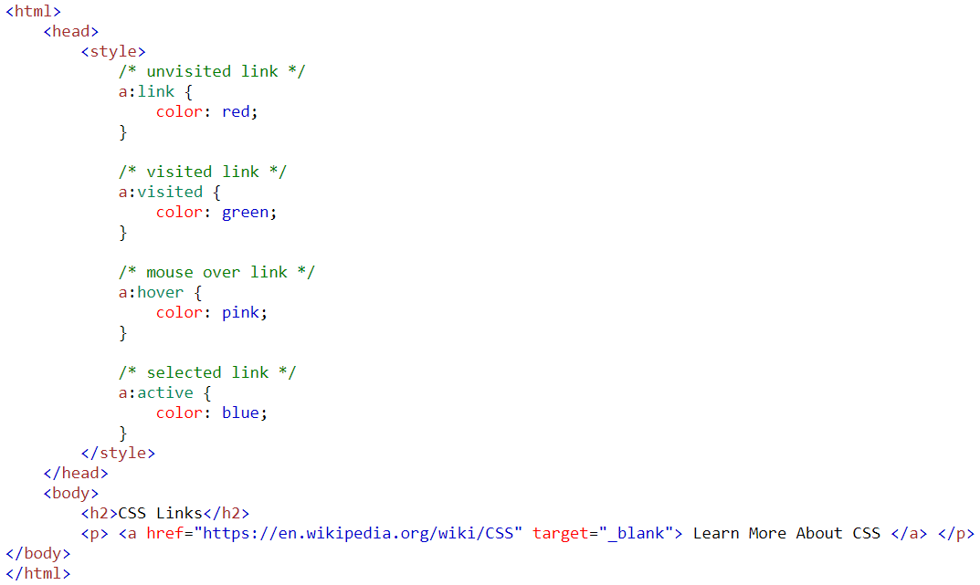
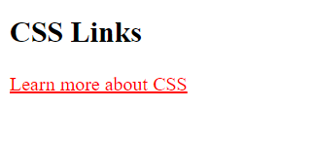
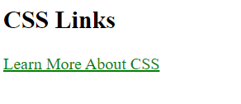
CSS Links (Contd.)
BCAC0016: Fundamentals of Internet Programming

Slide 44
CSS Links (Contd.)
Text Decoration
The text-decoration property is mostly used to remove underlines from links:
a:link { text-decoration: none; } a:visited { text-decoration: underline; } a:hover { text-decoration: underline; }
BCAC0016: Fundamentals of Internet Programming

Slide 45
CSS Links (Contd.)
Background Color
The background-color property is mostly used to specify a background color for links:
a:link { background-color: yellow; } a:visited { background-color: cyan; } a:hover { background-color: lightgreen; }
BCAC0016: Fundamentals of Internet Programming

Slide 46
CSS Margins

Slide 47
The CSS margin properties are used to create space around elements, outside of any defined borders.
With CSS, you have full control over the margins.
There are properties for setting the margin for each side of an element (top, right, bottom, and left).

Slide 48
Margin - Individual Sides
CSS has properties for specifying the margin for each side of an element:
margin-top
margin-right
margin-bottom
margin-left
All the margin properties can have the following values:
auto - the browser calculates the margin
length - specifies a margin in px, pt, cm, etc.
% - specifies a margin in % of the width of the containing element
inherit - specifies that the margin should be inherited from the parent element

Slide 49
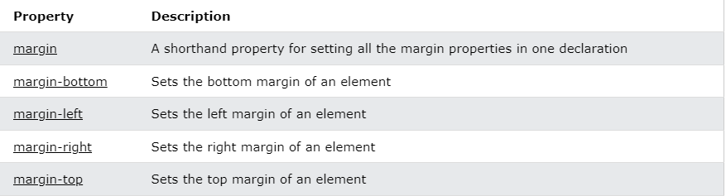
Margin properties

Slide 50
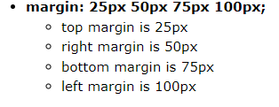
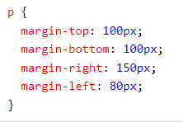

Cont…

Slide 51
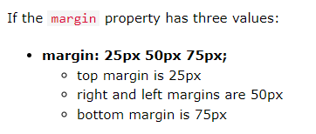

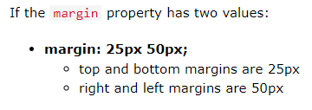

Cont…

Slide 52


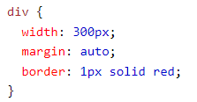
Cont…

Slide 53
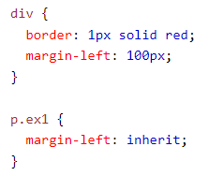
Cont…

Slide 54
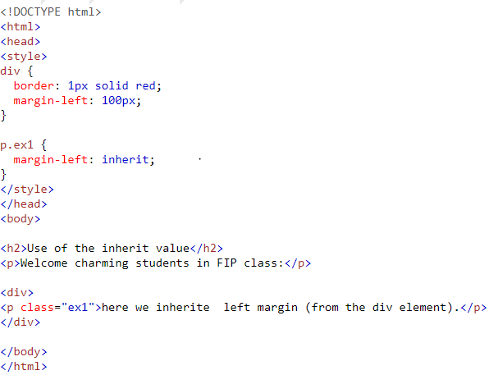
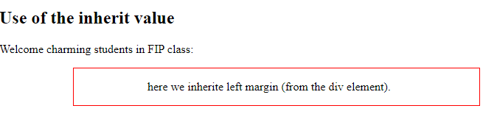

Slide 55
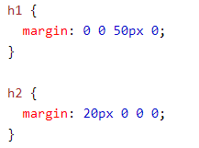
CSS Margin Collapse
Top and bottom margins of elements are sometimes collapsed into a single margin.
that is equal to the largest of the two margins.
<h1> element has a bottom margin of 50px and the
<h2> element has a top margin set to 20px.

Slide 56
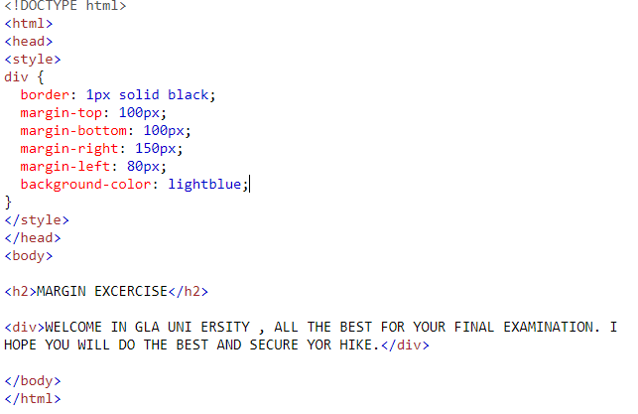


Slide 57
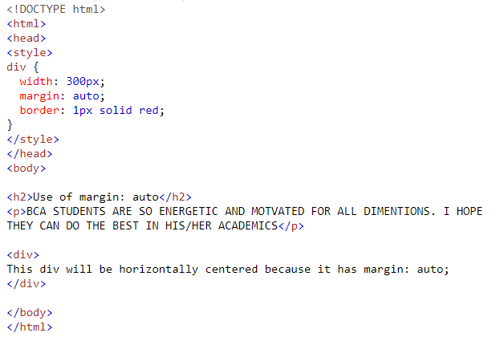
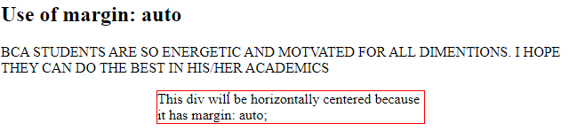

Slide 58
Thank You

